Slide 1
ENG 346
Data Structures and Algorithms for Artificial Intelligence
Object-Oriented Programming
Dr. Mehmet PEKMEZCİ
mpekmezci@gtu.edu.tr
https://github.com/mehmetpekmezci/GTU-ENG-346
ENG-346 Teams code is 0uv7jlm

Slide 2
Agenda
Object-Oriented Basics
Class Definitions
Encapsulation
Inheritance
Polymorphism
Operator Overloading
Examples

Slide 3
What is a Class?
A blueprint or template in object-oriented programming that defines the structure and behavior of objects.
An abstraction to a key concept through its structure and behavior.
Attributes: Data the class will be holding.
Methods: Operations on the data
Class encapsulates both data (attributes/properties) and behavior (methods/messages) making it easier to model and manipulate complex systems.

Slide 4
Example: Car Class
Class: Car
Attributes:
Color
Production Year
Maximum Speed
…
Methods:
Accelerate()
Decelerate()
Turn_on_the_lights()
…

Slide 5
What is an Object?
An object is an instance of a class.
  Realization of a Class
Objects represent real-world entities, concepts, or things in your program.
Notes:
In OOP, an object is a fundamental concept. It's an instance of a class, which is a blueprint or template for creating objects. Objects represent real-world entities, concepts, or things in your program. They encapsulate both data (attributes or properties) and behavior (methods or functions) related to those entities, making it easier to model and manipulate complex systems.

Slide 6
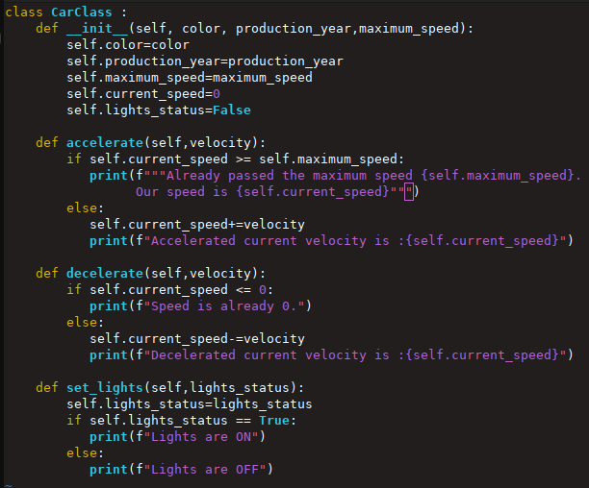
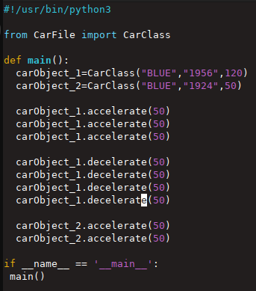
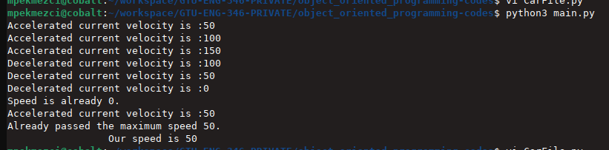
Example
CarFile.py
main.py
Notes:
In OOP, an object is a fundamental concept. It's an instance of a class, which is a blueprint or template for creating objects. Objects represent real-world entities, concepts, or things in your program. They encapsulate both data (attributes or properties) and behavior (methods or functions) related to those entities, making it easier to model and manipulate complex systems.

Slide 7
Example: My Car
Class: Car
Attributes:
Color
Production Year
Maximum Speed
…
Methods:
Accelerate()
Decelerate()
Turn_on_the_lights()
…
Object: My Car
Object: Wife’s Car
Attributes:
Color: Black
Production Year: 2010
Maximum Speed: 180
…
Attributes:
Color: White
Production Year: 2015
Maximum Speed: 170
…
Methods:
Accelerate()
Decelerate()
Turn_on_the_lights()
…
Methods:
Accelerate()
Decelerate()
Turn_on_the_lights()
…

Slide 8
Benefits of OOP
Modularity: Helps to organize the code. Example : a house or apartment can be viewed as consisting of several interacting units; electrical, heating, cooling, plumbing, structure, etc.
Reusability: Encourages code reuse at the Class level.
Abstraction: Abstraction is the process of hiding internal implementation details and showing only essential functionality to the user. It focuses on what an object does rather than how it does it.
Encapsulation: Bundling data (attributes) and the methods (functions) that operate on that data into a single unit.
Inheritance: Inherit attributes and methods from ancestors (parent classes).
Polymorphism: Treat subclasses as if they are of one type, the Superclass.
Scalability: Perform coding on large scale.
Ease of Maintenance: Code organization and modularity makes it easy to debug, localize bugs, and perform maintenance.
Team Collaboration: Work on individual classes without disturbing one another.
Real-World Modeling: Natural way of thinking, design, and programming.
Notes:
Modularity: OOP promotes modularity by organizing code into self-contained objects. Each object represents a specific entity or concept, making it easier to manage and maintain the codebase. Changes and updates can be made to one object without affecting others, reducing the risk of unintended side effects.
Reusability: OOP encourages code reuse through the creation of classes and objects. Once a class is defined, it can be used to create multiple objects with the same characteristics and behaviors. This reduces redundancy and saves development time.
Abstraction: OOP allows developers to abstract complex systems into simpler, high-level objects. This abstraction hides the implementation details, making it easier to understand and work with code. It also allows developers to focus on the essential features of an object without getting bogged down in the minutiae.
Encapsulation: Encapsulation is the practice of bundling data (attributes) and the methods (functions) that operate on that data into a single unit, the object. This concept promotes data security and prevents unauthorized access or modification of an object's internal state.
Inheritance: Inheritance is a mechanism in OOP that allows one class (the subclass or derived class) to inherit attributes and methods from another class (the superclass or base class). This promotes code reuse and the creation of specialized objects based on existing ones.
Polymorphism: Polymorphism enables objects of different classes to be treated as objects of a common superclass. This flexibility allows for the implementation of generic code that can work with a variety of objects, promoting extensibility and flexibility in your software.
Ease of Maintenance: OOP code tends to be more organized and modular, which makes it easier to debug and maintain. Changes to one part of the code are less likely to impact other parts, reducing the risk of introducing new bugs.
Team Collaboration: OOP encourages a collaborative development approach. Different team members can work on different classes and objects, reducing the likelihood of conflicts when integrating their code.
Scalability: OOP is well-suited for building scalable software systems. As the complexity of a project grows, OOP provides a structured approach to handling that complexity, allowing for the addition of new classes and objects as needed.
Real-World Modeling: OOP allows developers to model real-world entities and relationships more naturally. This makes it easier to translate real-world problems into code, improving the clarity of the software's design.

Slide 9
Modularity
Class: Car
Attributes:
Color
Production Year
Maximum Speed
Engine
Wheel[]
Doors[]…
MODULE
MODULE
Class: Engine
Methods:
Accelerate()
Decelerate()
Turn_on_the_lights()
…
Attributes:
power
…
Class: Door
Attributes:
door_type
…
Methods:
power_on()
power_off()
…
Methods:
open()
close()
…
MODULE
Class: Wheel
Attributes:
tire_type
…
Methods:
check_pressure()
...
…

Slide 10
Reusability
Class: Car
Class: Motorcycle
Attributes:
Color
Production Year
Maximum Speed
Engine
Wheel[]
Doors[]…
Attributes:
Color
Production Year
Maximum Speed
Engine
Wheel[]
Methods:
Accelerate()
Decelerate()
Turn_on_the_lights()
…
Methods:
Accelerate()
Decelerate()
…
MODULE
Class: Engine
Attributes:
power
…
Methods:
power_on()
power_off()
…

Slide 11
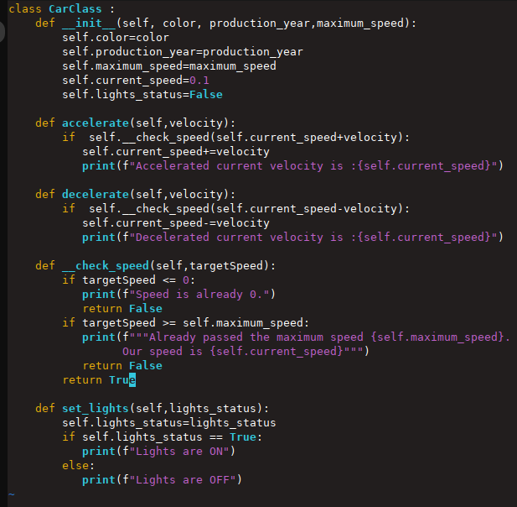
Abstraction
Class: Car
Attributes:
Color
Production Year
Maximum Speed
Engine
Wheel[]
Doors[]…
Methods:
Public Accelerate()
Public Decelerate()
Public Turn_on_the_lights()
Private __check_speed()

Slide 12
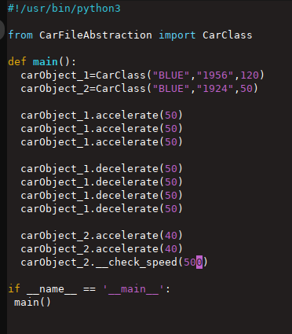
Abstraction

Slide 13
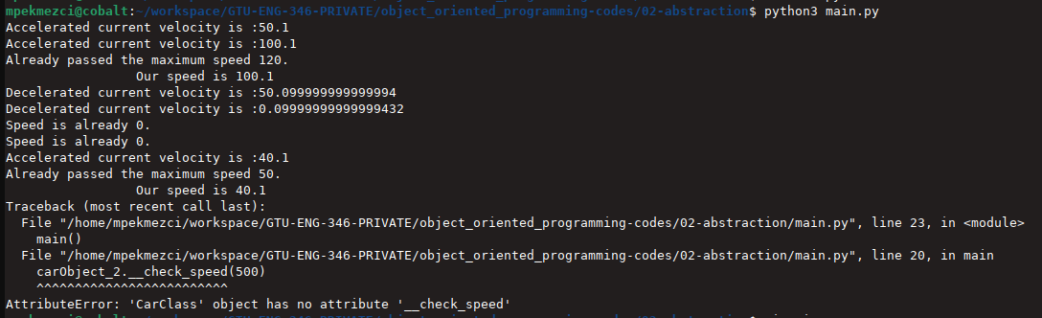
Abstraction

Slide 14
Encapsulation
Concept of bundling data (attributes/properties) and methods (functions/behaviors) that operate on that data into a Class.
Protects data from accidental modification.
Prevents the developer to forget the update the code for related concepts.
Enhances code organization.
Streamlines interaction between program components.

Slide 15
Inheritance
Hierarchical extension mechanism in OOP.
The subclass inherits attributes and behaviors from the superclass and can extend or override them.
Inheritance facilitates code reuse and allows you to model hierarchical relationships between classes.
Importance: Inheritance promotes code reusability, as you can create new classes that inherit features from existing classes, reducing code duplication. It also simplifies the organization of related classes in a hierarchy, making it easier to understand and maintain the code.

Slide 16
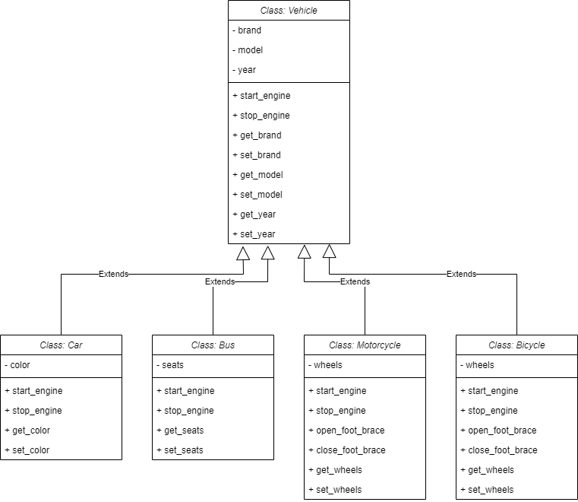
Inheritance – Example

Slide 17
Polymorphism
Subclasses are be treated as instances of a common superclass.
It allows objects of different classes to be accessed and manipulated through a common (Class) interface, often through inheritance and method overriding.
Importance: Polymorphism enhances flexibility and extensibility in OOP. It simplifies code by allowing you to write generic algorithms that can work with various objects without knowing their specific types. This makes it easier to adapt and extend software as new classes are added, leading to more maintainable and scalable code.

Slide 18
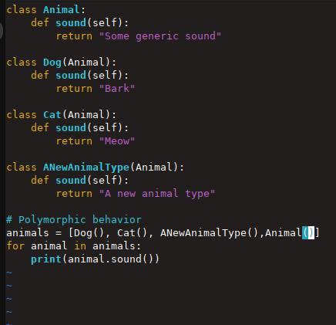
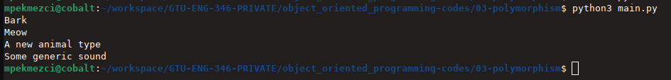
Polymorphism

Slide 19
Operator Overloading
Overloading common operators (such as + operator) to extend the functionality of a (new) class.
Example: Assume we are defining Complex Class and we want arithmetic operators to function on this new class.

Slide 20
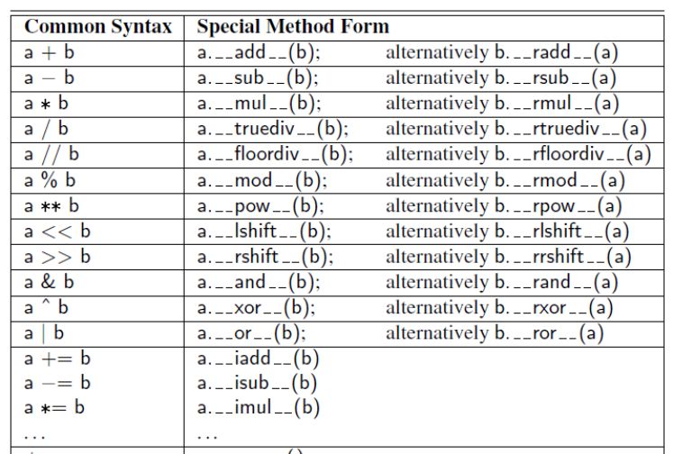
Operator Overloading – continued

Slide 21
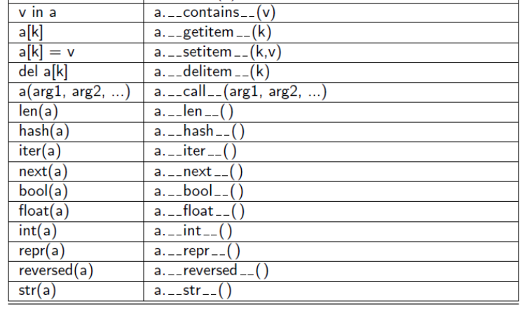
Non-Operator Overloads
Overloading commonly used Python functions, such as str(), len(), etc.

Slide 22
Named Variables in Function Definitions
Example: Range Class
class RangeClass:
def __init__ (self, start, stop=None, step=1):

